Slide 1
Introduction to Microeconomics

Slide 2
Lecture 16 Perfect Competition

Slide 3
The Theory of Perfect Competition
Perfect Competition
The theory of perfect competition is built on four assumptions:
There are many sellers and many buyers, none of which is large in relation to total sales or purchases.
Each firm produces and sells a homogeneous product.
Buyers and sellers have all relevant information about prices, product quality, sources of supply, and so forth.
Firms have easy entry and exit.

Slide 4
The Theory of Perfect Competition
A Perfectly Competitive Firm Is a Price Taker
A perfectly competitive firm is a price taker because it does not have the ability to control the price of its product; it “takes” the price determined in the market.
Why is a perfectly competitive firm a price taker?
A firm is restrained from being anything but a price taker if it finds itself one among many firms where its supply is small relative to the total market supply (assumption 1), and it sells a homogeneous product (assumption 2) in an environment where buyers and sellers have all relevant information (assumption 3).

Slide 5
The Theory of Perfect Competition
A Perfectly Competitive Firm Is a Price Taker
As an example, consider the market for milk.
No single consumer of milk can influence the price of milk because each buyer purchases a small amount relative to the size of the market.
Similarly, each dairy farmer has limited control over the price because many other sellers are offering milk that is essentially identical.

Slide 6
The Theory of Perfect Competition
A Perfectly Competitive Firm Is a Price Taker
Because each seller can sell all he wants at the going price, he has little reason to charge less, and if he charges more, buyers will go elsewhere.
Buyers and sellers in competitive markets must accept the price the market determines and, therefore, are said to be price takers.

Slide 7
The Theory of Perfect Competition
The Demand Curve for a Perfectly Competitive Firm Is Horizontal
The perfectly competitive setting has many sellers and many buyers. Together, all buyers make up the market demand curve; together, all sellers make up the market supply curve.
An equilibrium price is established at the intersection of the market demand and market supply curves [Exhibit 1(a)].
When the equilibrium price has been established, a single perfectly competitive firm faces a horizontal (flat, perfectly elastic) demand curve at the equilibrium price [Exhibit 1(b)].

Slide 8
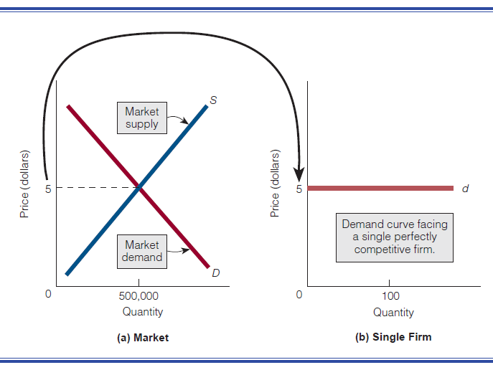
The Theory of Perfect Competition
The Demand Curve for a Perfectly Competitive Firm Is Horizontal
In short, the firm takes the equilibrium price as given—hence the firm is a price taker—and sells all quantities of output at this price.

Slide 9
The Theory of Perfect Competition
The Demand Curve for a Perfectly Competitive Firm Is Horizontal
Why does a perfectly competitive firm Sell at equilibrium price?
If a perfectly competitive firm tries to charge a price higher than the market-established equilibrium price, it won’t sell any of its product.
The reasons are that the firm sells a homogeneous product, its supply is small relative to the total market supply, and all buyers are informed about where they can obtain the product at the lower price.

Slide 10
The Theory of Perfect Competition
The Demand Curve for a Perfectly Competitive Firm Is Horizontal
Why does a perfectly competitive firm Sell at equilibrium price?
If the firm wants to maximize profits, it does not offer to sell its good at a lower price than the equilibrium price.
Why should it?
It can sell all it wants at the market-established equilibrium price. The equilibrium price is the only relevant price for the perfectly competitive firm.

Slide 11
The Theory of Perfect Competition
The Marginal Revenue Curve of a Perfectly Competitive Firm Is the Same as Its Demand Curve
Total revenue is the price of a good multiplied by the quantity sold.
If the equilibrium price is $5, as in Exhibit 2(a), and the perfectly competitive firm sells 3 units of its good, its total revenue is $15.
If the firm sells an additional unit, bringing the total number of units sold to 4, its total revenue is $20.

Slide 12
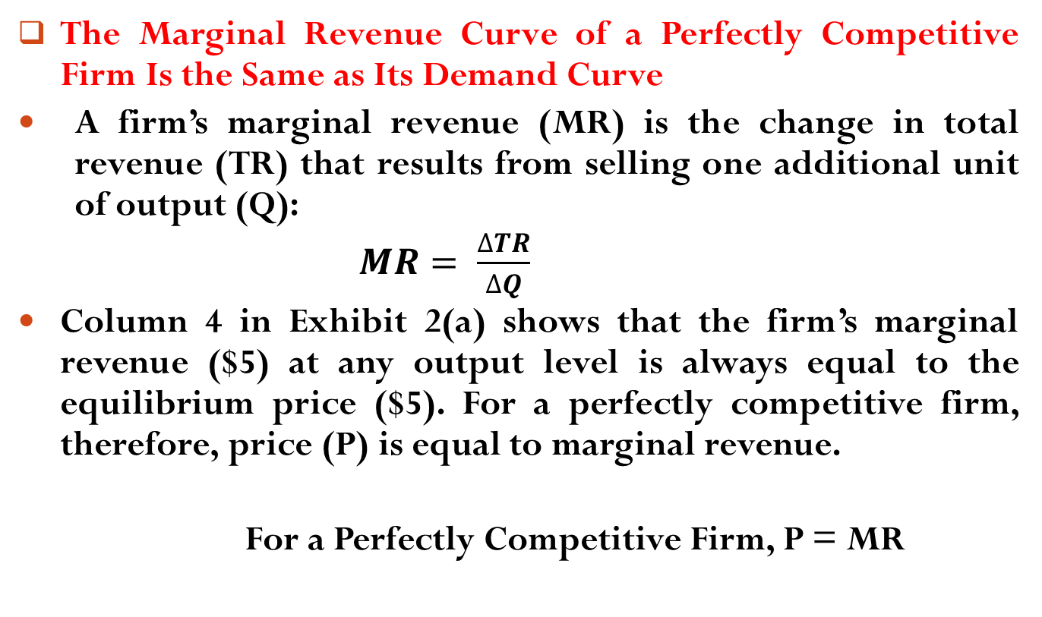
The Theory of Perfect Competition
The Marginal Revenue Curve of a Perfectly Competitive Firm Is the Same as Its Demand Curve
A firm’s marginal revenue (MR) is the change in total revenue (TR) that results from selling one additional unit of output (Q):
$MR= \frac{∆TR}{∆Q}$
Column 4 in Exhibit 2(a) shows that the firm’s marginal revenue ($5) at any output level is always equal to the equilibrium price ($5). For a perfectly competitive firm, therefore, price (P) is equal to marginal revenue.
For a Perfectly Competitive Firm, P = MR

Slide 13
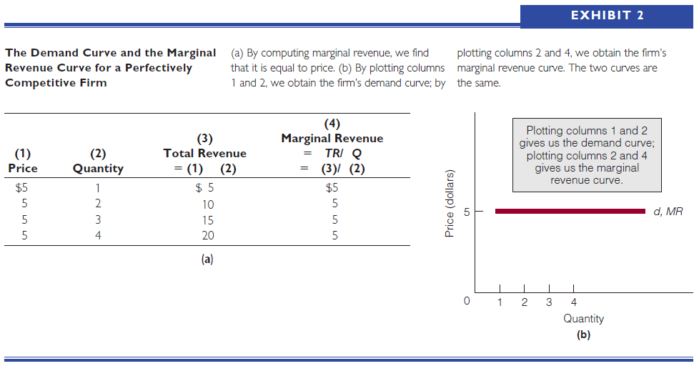
The Theory of Perfect Competition
The Marginal Revenue Curve of a Perfectly Competitive Firm Is the Same as Its Demand Curve

Slide 14
The Theory of Perfect Competition
The Marginal Revenue Curve of a Perfectly Competitive Firm Is the Same as Its Demand Curve
A firm’s marginal revenue (MR) is the change in total revenue (TR) that results from selling one additional unit of output (Q):
$MR= \frac{∆TR}{∆Q}$
Column 4 in Exhibit 2(a) shows that the firm’s marginal revenue ($5) at any output level is always equal to the equilibrium price ($5). For a perfectly competitive firm, therefore, price (P) is equal to marginal revenue.
For a Perfectly Competitive Firm, P = MR

Slide 15
Perfect Competition in the Short Run
What Level of Output does the Profit-Maximizing Firm Produce?
In Exhibit 3, the perfectly competitive firm’s demand curve (d ) and marginal revenue curve (MR, which is the same as d ) are drawn at the equilibrium price of $5.
The firm’s marginal cost curve (MC) is also shown.
On the basis of these curves, the firm will continue to increase its quantity of output as long as marginal revenue is greater than marginal cost.

Slide 16
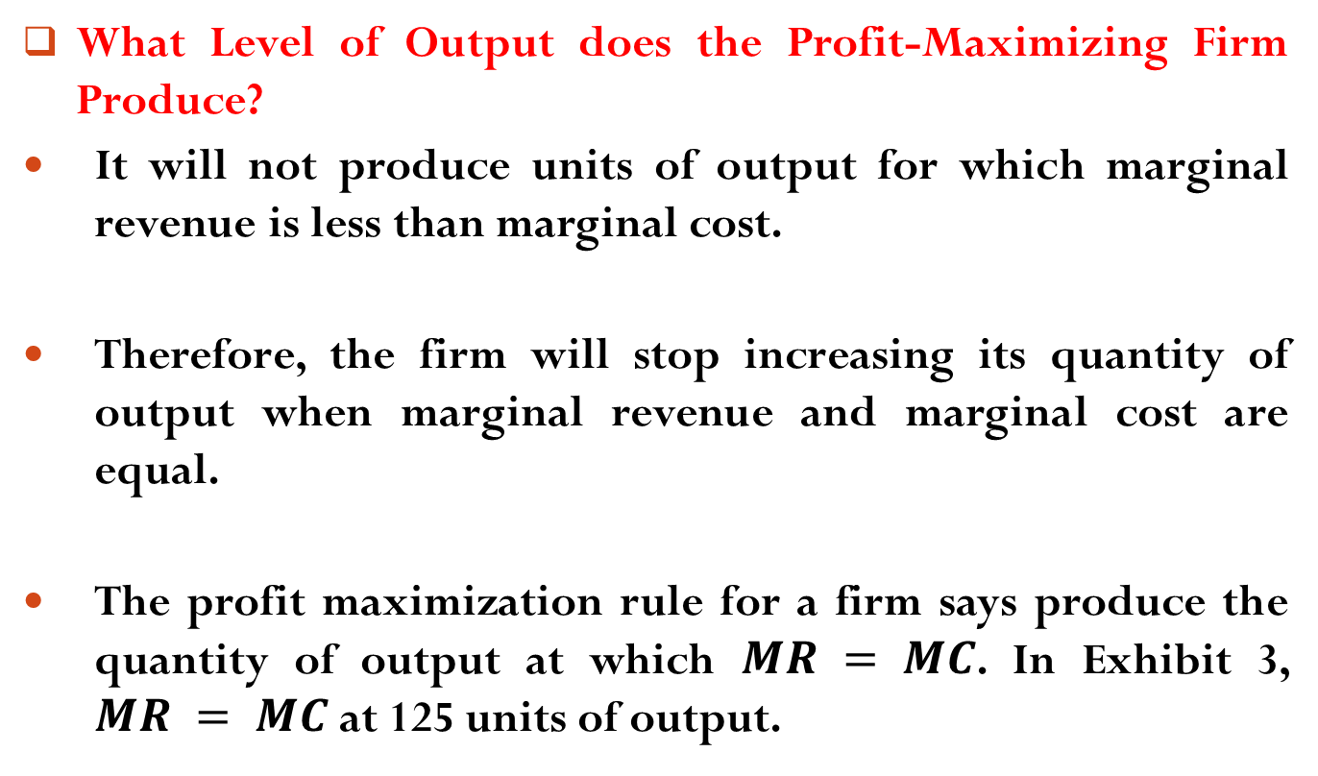
Perfect Competition in the Short Run
What Level of Output does the Profit-Maximizing Firm Produce?
It will not produce units of output for which marginal revenue is less than marginal cost.
Therefore, the firm will stop increasing its quantity of output when marginal revenue and marginal cost are equal.
The profit maximization rule for a firm says produce the quantity of output at which $MR = MC$. In Exhibit 3, $MR = MC$at 125 units of output.

Slide 17
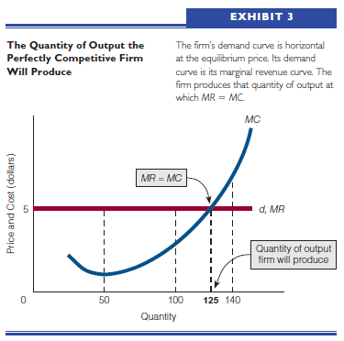
Perfect Competition in the Short Run
What Level of Output does the Profit-Maximizing Firm Produce?

Slide 18
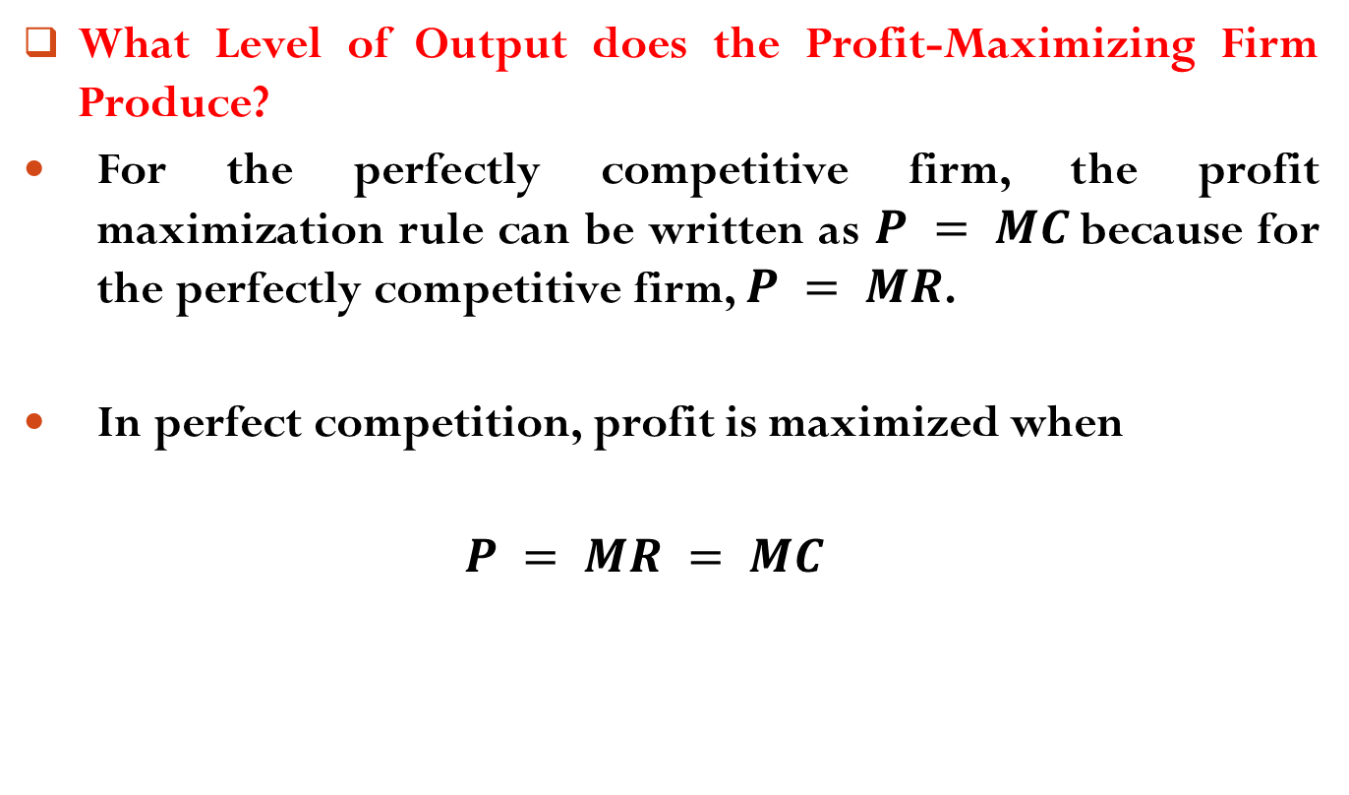
Perfect Competition in the Short Run
What Level of Output does the Profit-Maximizing Firm Produce?
For the perfectly competitive firm, the profit maximization rule can be written as $P = MC$because for the perfectly competitive firm, $P = MR$.
In perfect competition, profit is maximized when
$P = MR = MC$

Slide 19
Perfect Competition in the Short Run
To Produce or Not to Produce: That Is the Question
The following cases illustrate three applications of the profit maximization (loss minimization) rule by a perfectly competitive firm.
Case 1: Price Is Above Average Total Cost
Exhibit 4(a) illustrates the perfectly competitive firm’s demand and marginal revenue curves.
If the firm follows the profit maximization rule and produces the quantity of output at which marginal revenue equals marginal cost, it will produce 100 units of output—the profit-maximizing quantity of output.

Slide 20
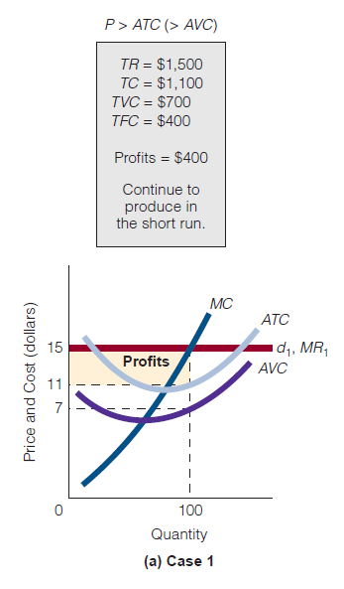
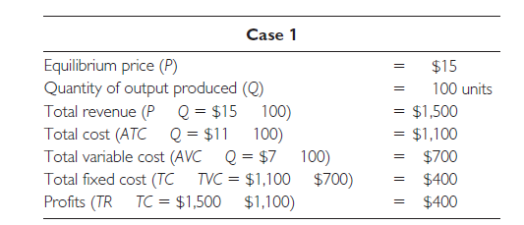
Perfect Competition in the Short Run
To Produce or Not to Produce: That Is the Question
At this quantity of output, price is above average total cost. Using the information in the exhibit, we can make the following calculations:

Slide 21
Perfect Competition in the Short Run
To Produce or Not to Produce: That Is the Question
Therefore, for the perfectly competitive firm, if price is above the average total cost, the firm maximizes profits by producing the quantity of output at which MR = MC.

Slide 22
Perfect Competition in the Short Run
To Produce or Not to Produce: That Is the Question
Case 2: Price Is Below Average Variable Cost
Exhibit 4(b) illustrates the case in which price is below the average variable cost.
The equilibrium price at which the perfectly competitive firm sells its good is $4.
At this price, total revenue is less than both total cost and total variable cost, as the following calculations indicate. To minimize its loss, the firm should shut down.

Slide 23
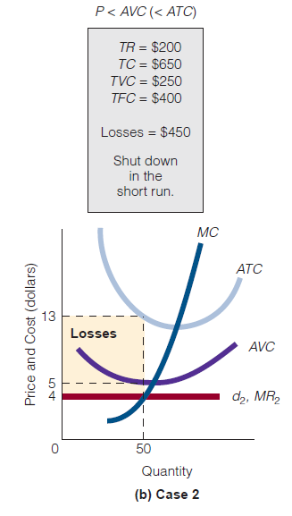
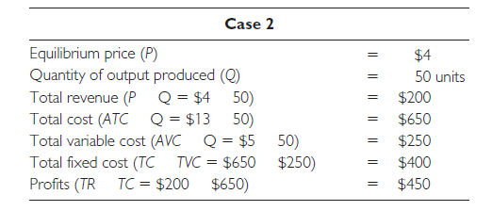
Perfect Competition in the Short Run
To Produce or Not to Produce: That Is the Question
Case 2: Price Is Below Average Variable Cost

Slide 24
Perfect Competition in the Short Run
To Produce or Not to Produce: That Is the Question
Case 2: Price Is Below Average Variable Cost
If the firm produces in the short run, it will take a loss of $450.
If it shuts down, its loss will be less, losing its fixed costs, which amount to the difference between total cost and variable cost (TFC + TVC = TC, so TC - TVC = TFC). This is $400 ($650 - $250).
So between the two options of producing in the short run or shutting down, the firm minimizes its losses by choosing to shut down (Q = 0).

Slide 25
Perfect Competition in the Short Run
To Produce or Not to Produce: That Is the Question
Case 2: Price Is Below Average Variable Cost
It will lose $400 by shutting down, whereas it will lose $450 by producing in the short run.
Therefore, if price is below the average variable cost, the perfectly competitive firm minimizes losses by choosing to shut down—that is, by not producing.

Slide 26
Perfect Competition in the Short Run
To Produce or Not to Produce: That Is the Question
Case 3: Price Is Below Average Total Cost But Above Average Variable Cost
Exhibit 4(c) illustrates the case in which price is below average total cost but above average variable cost.
The equilibrium price at which the perfectly competitive firm sells its good is $9. If the firm follows the profit maximization rule, it will produce 80 units of output.
At this price and quantity of output, total revenue is less than total cost (hence, the firm will incur a loss), but total revenue is greater than total variable cost. The calculations are as follows:

Slide 27
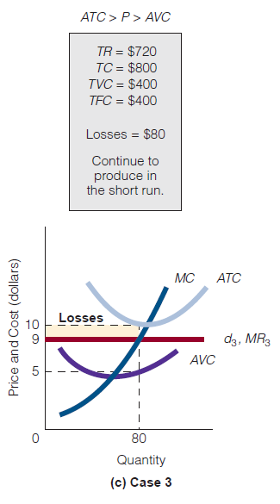
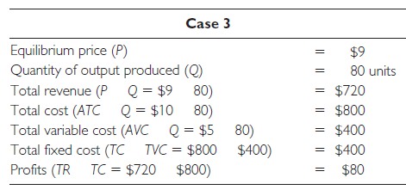
Perfect Competition in the Short Run
To Produce or Not to Produce: That Is the Question
Case 3: Price Is Below Average Total Cost But Above Average Variable Cost

Slide 28
Perfect Competition in the Short Run
To Produce or Not to Produce: That Is the Question
Case 3: Price Is Below Average Total Cost But Above Average Variable Cost
If the firm decides to produce in the short run, it will take a loss of $80. If it shuts down, it will lose its fixed costs, which, in this case, are $400 (TC - TVC = $800 – $400).
Continuing to produce in the short run is better than to shutting down. Losses are minimized by producing.
Therefore, if price is below average total cost but above average variable cost, the perfectly competitive firm minimizes its losses by continuing to produce in the short run instead of shutting down.

Slide 29
Perfect Competition in the Short Run
Common Misconceptions over the Shutdown Decision
Asked when a business firm should shut down (stop producing), the layperson is likely to say when the firm is no longer earning a profit.
In economics, that is when price is lower than average total cost (P < ATC). But that could be the wrong way to go, as we have just shown.
Even if price is below average total cost and a loss is being incurred, a firm should not necessarily shut down.

Slide 30
Perfect Competition in the Short Run
Common Misconceptions over the Shutdown Decision
The shutdown decision depends, in the short run, on whether the firm loses more by shutting down than by not shutting down.
Even though price is below average total cost, it could still be above average variable cost, and, if it is, the firm minimizes its losses (in the short run) by continuing to produce than by shutting down.

Slide 31
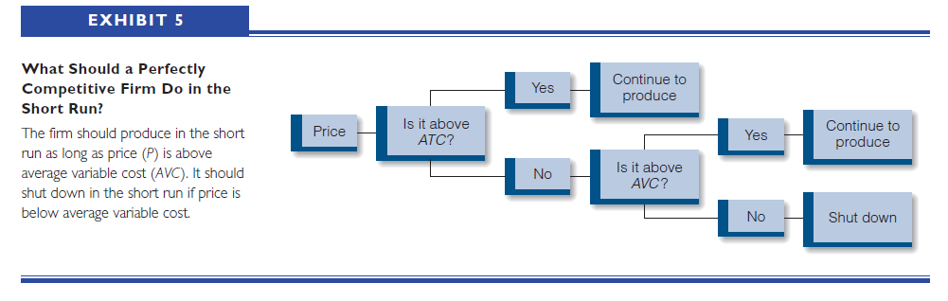
Perfect Competition in the Short Run
In Summary

Slide 32
Readings
Roger A. Arnold- Microeconomics, 10th Edition, Chapter – 9.

Slide 33


Slide 34
Thank You

